Slide 1
Education Reform Commission WELCOME
The Honorable Nathan Deal, Governor
June 23, 2015

Slide 2
AGENDA
Welcome
Approval of Minutes from May 20, 2015 Meeting
Report of Progress by each Sub-Committee
Funding
Early Childhood
Move on When Ready
Teacher Recruitment, Retention, Compensation
Expanding Educational Options
Discussion by Commission Members
Next Meeting – July 28, 2015 – DECAL 854
Public Comment
Adjourn

Slide 3
Funding Formula Committee
Report to Full Education Reform Commission
June 23, 2015

Slide 4
Briefing on Recent Events
Request to Governor Deal from Legislative Members to delay Funding Formula Committee recommendations
Response from Governor Deal to Legislators
New Deadline for Funding Committee Recommendations:
December 18, 2015

Slide 5
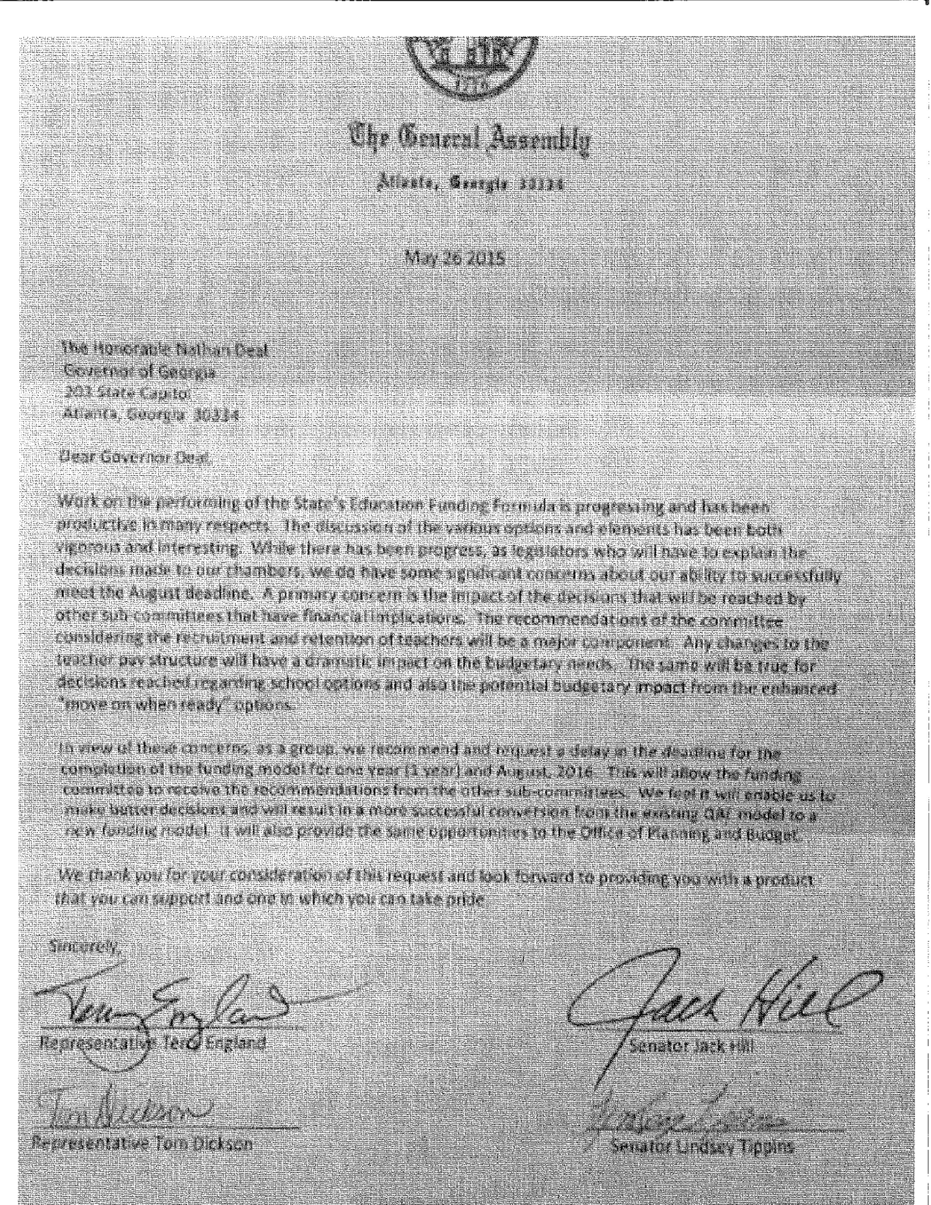

Slide 6
Preliminary Consensus To Date
Grade bands in formula will include:
K-3
4-8
9-12
Grades 4-8 will serve as the base weight for student funding.
Specific student characteristics and state initiatives will be weighted.

Slide 7
Characteristics/Initiative to be Weighted
Students in Grades K-3 will be weighted to support reading on grade level by Grade 3.
Students in Grades 9 – 12 will be weighted to acknowledge increased costs of college and career ready preparation.
Gifted students will be weighted to acknowledge extra expense of courses and activities.

Slide 8
Preliminary Consensus Reached But Additional Information Requested
Students with Disabilities will be weighted. Staff working with DOE to provide additional information on specific cost factors.
CTAE students in 9-12 will be weighted. Discussion will continue on weighting CTAE students in grades 6-8.
ESOL students will be weighted. Additional information requested on exit protocols.
Economically Disadvantaged students will be weighted. Additional information requested on how DOE uses Census Data to determine Title I allocations to districts.

Slide 9
Items for Continued Discussion
Should committee determine the total cost of education and/or the costs of various components that will go into the formula base?
What are the funding mechanisms of other States who perform better academically on NAEP than Georgia?
Should Teacher Training and Experience be in the base?
If T & E goes into the base, how might the State transition from current use of T & E to a more flexible teacher salary schedule?
How might the State incentivize a consolidation of services in small districts?
How can transportation costs be included in a low-enrollment categorical grant to replace Sparsity grant?

Slide 10
Questions from Commission Members

Slide 11
Early Childhood Education Subcommittee Update
Amy M. Jacobs, Commissioner
June 23, 2015

Slide 12
Governor Deal’s Charge
To the Early Childhood Education Subcommittee:
Study and make recommendations for the expansion of early educational options, including expanding Pre-K in Georgia and increasing access to quality rated programs for all kids, from birth to age five. This will require addressing our current funding formula for Georgia Pre-K as well as considering innovative approaches for getting more children in high quality programs.

Slide 13
Goal of the Subcommittee
Goal
Provide recommendations on ways to increase overall access to high quality early childhood programs for all Georgia's children.
Objectives
Identify strategies to expand Georgia’s Pre-K Program
Identify strategies to expand Quality Rated, Georgia’s tiered quality rating and improvement system
Specifically, achieving 100% of all child care providers participating in Quality Rated by the end of 2017
Increase the number of children with high needs who are served in high quality care

Slide 14
Quality Rated – What?
Priority of Governor Deal that Georgia would have a tiered quality rating and improvement system.
Georgia’s systemic approach to assess, improve, and communicate the level of quality in early care and education programs.
Similar to rating systems for other service-related industries like hotels and restaurants, Quality Rated assigns a 1-, 2-, or 3-star rating to early and school‐age care and education programs that meet a set of defined program standards.

Slide 15
Quality Rated – Why?
Findings from studies of child care quality conducted independent of DECAL indicated that:
Over 3/4 of family day care homes in Georgia were scored as "low quality."
Over 2/3 of infant/toddler care classrooms were scored as "low quality."
Over 1/3 of preschool (non Georgia Pre-K) classrooms were scored as "low quality.“

Slide 16
Quality Rated – Where Are We Now?
 | Not Rated | 1-Star | 2-Star | 3-Star | Total
Child Care Learning Center | 14 | 131 | 210 | 76 | 431
Family Day Care Home | 9 | 31 | 64 | 53 | 157
Group Day Care Home | 2 | 6 | 4 | 3 | 15
Other | 2 | 12 | 22 | 7 | 43
TOTAL | 27 | 180 | 300 | 139 | 646

Slide 17
Strategies to Increase Access to Quality**
Increasing access to quality is what matters
Strategies to consider
Tax Policy
Child Care Subsidy Policy
**Source for following slides: Anne Mitchell, Alliance for Early Childhood Finance, Center on Enhancing Early Learning Outcomes (CEELO)

Slide 18
Using Tax Policy
Tax policy uses public funds to generate much greater private investment
Tax policy can reward taxpayer’s for desired behavior, e.g., investing in quality or other outcomes
Taxes are familiar, accepted, and relatively stable.

Slide 19
Louisiana's School Readiness Tax Credits
Package of five credits enacted 2007:
Child Care Provider Credit
Credit for Directors and Staff
Parent Credit for Child Care Expenses
Business Support Credit
Resource and Referral Agency Credit

Slide 20
Effects of Provider Credit
Notes:
More higher quality programs over time
And
More needy children in higher quality
2008 -- % in rated program was 53% -- rose to 67% by 2011
(LA definition – subsidy or foster care, have data source for both)

Slide 21
Effects of the Parent Credit

Slide 22
Using Child Care Subsidy Policy
Child care subsidies provided through the federally funded Childcare and Parent Services (CAPS) Program
Provides subsidized child care to low income families
Currently providing services to over 55,000 children weekly
Services are available in all 159 counties
Eligibility guidelines for families
Income requirement
State approved activity requirement

Slide 23
CAPS and Quality Rated
8,480 children receiving CAPS with 329 Quality Rated providers
15% of all children receiving CAPS
362 Quality Rated providers currently accept children with CAPS
Tiered Reimbursement
Tiered bonus paid to rated providers for each child subsidized by CAPS
1 Star – 2%
2 Star – 5%
3 Star – 10%

Slide 24
Under Consideration
Support the cost of quality: Design a set of tax credits anchored to Quality Rated
Provider
Staff (Directors, Teachers)
Parent
Continue to improve CAPS policy (tiered reimbursement, copays) tied to Quality Rated

Slide 25
Questions from Commission Members

Slide 26
Move on When Ready Update
Education Reform Commission
June 2015

Slide 27
Charge to MOWR Subcommittee
A seamless system for moving students to the next educational level when they are ready requires the following:
Additional options for demonstrating competency.
Additional opportunities for internships and applied learning.
Smooth and efficient collaboration among Georgia’s K-12 education system, the College and Career System, and the University System.
Governor Deal charges the MOWR subcommittee to explore and make recommendations for the most efficient and effective methods to accomplish this goal.

Slide 28
MOWR | Education Committees’ Updates
Grades K-5
Grades 6-8
Grades 9 - 12
Will meet with teachers this summer and students/parents in the fall to understand why students are failing.
Discussed process of writing and executing a new plan to implement for a school district.
Shared action steps from other institutions around the nation that have been implemented to increase the number of HS students who earn a postsecondary credential.
Discussed four common elements of competency-based learning.

Slide 29
Henry County School Teachers & Administrators
Teachers and administrators shared positive experiences with competency-based learning.
Testing
Flexible Class times
Projects

Slide 30
National History Day Project
National History Day– National program that allows student to pick anything that interests them, according to the program’s theme.
Students conduct master-level research.
Gives students the opportunities to go “outside the school walls” to delve deep into a particular subject.
Picture on the right: Student’s website project on Dr. Joseph Goldberger.
Web Address: http://80884175.nhd.weebly.com/

Slide 31
3 Pathways for HIGH SCHOOL STUDENTS
College
College & Career
Career

Slide 32
Questions?

Slide 33
Teacher Recruitment, Retention and Compensation
Update from the Subcommittee
June 23, 2015

Slide 34
Since our last meeting…
Met with Governor’s Teacher Advisory Council
14 teachers from across Georgia
Gave compiled feedback from teacher input sessions
Discussed possibility of new compensation model at local level

Slide 35
Where we are going….
Tomorrow we will be meeting with:
Representatives from TNTP (The New Teacher Project)
Representatives from NCTQ (National Center for Teacher Quality)
Representatives from GaPSC Certification to talk about Tiered Certification and Professional Learning

Slide 36
In the weeks to come….
July…
Meet with Georgia Association of School Personnel Administrators at GAEL
Begin formulating recommendations as a subcommittee based on input and presentations
August/September: Work in conjunction with Funding Subcommittee to flesh out recommendations

Slide 37
Questions from Commission Members

Slide 38
Educational Options / School Choice Subcommittee
June 23, 2015

Slide 39
Progress since last meeting
Presentations on:
Educational Savings Accounts
Student Scholarship Tax Credits
Special Needs Vouchers
Homeschooling
Non-Traditional Educational Centers

Slide 40
Educational Savings Accounts
ESAs are accounts held by parents to use on a wide variety of educational expenses for their child:
Private school tuition; Tutoring; Therapy for students with disabilities; Instructional materials/curriculum; Online programs/courses; Exam fees; Savings for future college costs
Have been adopted in Florida, Arizona, Tennessee, Mississippi, Nevada

Slide 41
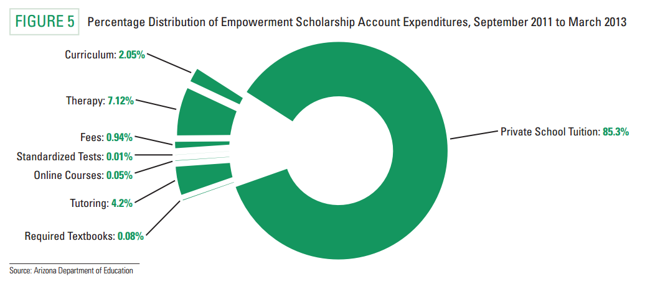

Slide 42
Educational Savings Accounts Lessons learned from other States
ESA accounts require a robust system of oversight (account monitoring and auditing).
ESA programs can make use of vendor codes and product codes when the program reaches scale (4,000 or so students). Until reaching this scale account oversight is labor intensive but feasible.
Choose your oversight agency/implementer carefully and give them a generous administration allowance that tapers down as the program grows.
Lawmakers should have a healthy discussion about academic transparency but testing should be the responsibility of the parent or guardian in a multi-provider program.
ESA programs initially require a large amount of administrative rule making, but Arizona and Florida have good rules to work from.

Slide 43
Student Scholarship Tax Credits
Wide range of perspectives offered
Most agreed that contribution limit should be increased, but there was disagreement whether the increase should occur within the existing program or through a new program
Some discussion of staggered contribution deadlines to increase corporations’ ability to contribute
There was a sharp difference of opinion regarding whether income limits should be applied to recipients
Nearly uniform agreement that lost cap dollars should be recovered

Slide 44
Special Needs Scholarships
Program participation has grown from under 1000 in 2007-08 to over 3000 in 2012-13
Average scholarship is $5747, with a range from $2196 - $12,803
Growth inhibitors
Scholarship amounts
Lack of knowledge of eligibility
Lack of flexibility in use of funds
Lack of adequate enrollment dates
Needs best met in traditional public school
Sample recommendations
Expand eligibility
ESA-style flexibility in use of funds
Broader data collection
Supplement to scholarship amount

Slide 45
Homeschooling
53,000 homeschooled students in 2014, up 24% since 2010
Recent changes in documentation shifted declaration of intent from local systems to DOE
2 key issues:
challenges in taking PSAT and AP tests
admissions to USG schools

Slide 46
Non-Traditional Educational Centers
Defined by Georgia Accrediting Commission as those centers serving home-educated students a maximum of 60% of the time, with the students studying at home or other parent-designated location the remainder
Wide range of approaches and formats
Impact of accreditors

Slide 47
Next steps
Subcommittee members develop initial drafts of recommendations
Meeting of subcommittee at which drafts are discussed and public comment is taken; no presentations
Subcommittee members revise recommendations based on discussion and comment
Final meeting of subcommittee at which revised recommendations are discussed and voted on

Slide 48
Q & A from Commissioners

Slide 49
Education Reform Commission
Web-site:
https://gov.georgia.gov/education-reform-commission
E-mail address for public comment:
erc@opb.georgia.gov

